Slide 1
Maynard Operation Sequence Technique (MOST)
The Maynard Operation Sequence Technique (MOST) is a high-level predetermined motion time system (PMTS) that is based on MTM.
MOST is a work measurement technique that concentrates on the movement of objects. It is used to analyze work and to determine the normal time that it would take to perform a particular process /operation.
The basic version of MOST which is now referred to as Basic MOST.

Slide 2
Maynard Operation Sequence Technique (MOST)
More specifically, MOST is used to:
  1. Break down the operation/process into smaller steps/units
  2. Analyze the motions in each step/unit by using a standard
  MOST method sequence
  3. Assign indices to the parameters constituting the method
  sequence for each task
  4. Sum up the indices to arrive at a time value for each step/unit
  5. Sum up the time values for all the steps/units to arrive at the ‘normal time’ required to perform that operation/process

Slide 3
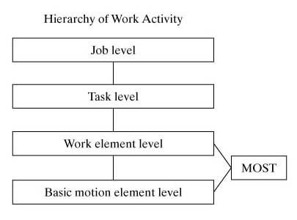
MOST in the Work Pyramid
Figure 14.2 The position of the Basic MOST activity sequence model in our work hierarchy

Slide 4
Basic MOST
The focus of Basic MOST is on work activity involve the movement of objects. The majority of industrial manual work does involve moving objects (e.g., parts, tools) from one location to another in the workplace.
Basic MOST uses motion aggregates (collections of basic motion elements) that are concerned with moving things. The motion aggregates are called activity sequence models in Basic MOST.
There are three activity sequence models in Basic MOST, each of which consists of a standard sequence of actions:
  General move. This sequence model is used when an object is moved freely through space from one location to the next (e.g., picking something up from the floor and placing it on a table).
  Controlled move. This sequence model is used when an object is moved while it remains in contact with a surface (e.g., sliding the object along the surface) or the object is attached to some other object during its movement (e.g., moving a lever on a machine).
  Tool use. This sequence model applies to the use of a hand tool (e.g., a hammer or screwdriver).

Slide 5
The actions in an activity sequence model, called sequence model parameters in Basic MOST, are similar to basic motion elements in MTM. Let us examine the three sequence models and indicate the standard sequence of model parameters for each.
General Move. The General Move sequence is applicable when an object is moved through the air from one location to another. There are four parameters (actions) in the General Move, symbolized by letters of the alphabet:
A — Action distance, usually horizontal. This parameter is used to describe movements of the fingers, hands, or feet (e.g., walking). The movement can be per formed either loaded or unloaded.
B — Body motion, usually vertical. This parameter defines vertical body motions and actions (e.g., sitting, standing up).
G — Gain control. This parameter is used for any manual actions involving the fingers, hands, or feet to gain physical control of one or more objects. ft is closely related to the grasp motion element in MTM (e.g., grasp the object).
P — Placement. The placement parameter is used to describe the action involved to lay aside, position, orient, or align an object after it has been moved to the new location (e.g., position the object).

Slide 6
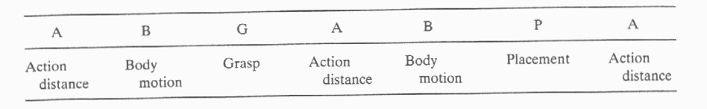
These parameters occur in the following standard sequence in the General Move:
where the first three parameters (A B G) represent basic motions to get an object, the next three parameters (A B P) represent motions to put or move the object to a new location, and the final parameter (A) applies to any motions at the end of the sequence, such as return to original position.
To complete the activity sequence model, each parameter is assigned a numerical value in the form of a subscript or index number that represents the time to accomplish that action.

Slide 7
The value of the index number depends on the type of action, its motion content, and the conditions under which it is performed. Table 14.6 lists the parameters and possible circumstances for the action, together with the corresponding values of the index numbers.
When the index values have been entered for all parameters, the time for the sequence model is determined by summing the index values and multiplying by 10 to obtain the total TMUs. The procedure is illustrated in the following example.
Example: General Move
Develop the activity sequence model and determine the normal time for the following work activity: A worker walks 5 steps, picks up a small part from the floor, returns to his original position, and places the part on his worktable.

Slide 8
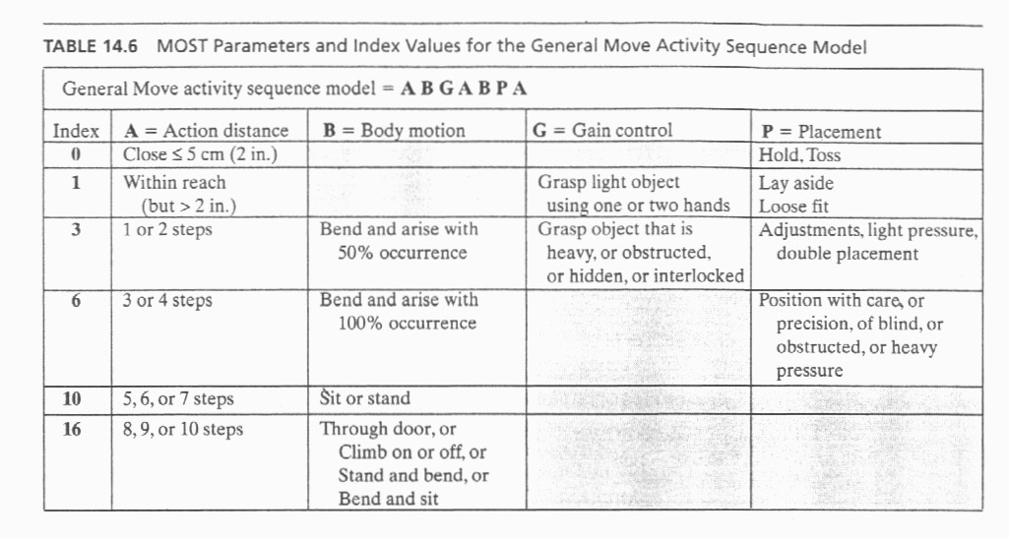
Solution: Referring to Table 14.6, the indexed activity sequence model for this work activity would be the following:
A₁₀ B₆ G₁ A₁₀ B₀ P₁ A₀
where A₁₀ = walk 5 steps, B₆ = bend and arise, G₁ = control of small part, A₁₀ = walk back to original position, B₀ = no body motion, P₁ = lay aside part on table, and A₀ = no motion. The sum of the index values is 28. Multiplying by 10, we have 280 TMUs (about 10 sec).

